Slide 1
Towards a Robust Query Optimizer:
A Principled and Practical Approach
ACM Sigmod Conference, 2005
Babcock B. and Chaudhuri S.
Presented by:
Esma Kılıç

Slide 2

Outline
Introduction
  Query Optimizer
  An Alternative Approach to Query Optimization
Cardinality Estimation
Related Work
The New Approach
  The Performance/Predictability Tradeoff
  Incorporating the Probability Distribution
Analysis of the Approach
Experiments
Future Work
Conclusion

Slide 3
Introduction
Query Optimizer
The task: To select a low-cost query plan.
The difficulty: Only incomplete and imprecise information about query plan cost is available to the optimizer at query compilation time.
The standard approach:
  First, generate rough guesses as the values of the relevant cost model parameters using some statistics of the data.
  Next, using rough guesses as inputs, invoke a search algorithm to find the least costly plan.

Slide 4
Introduction
An Alternative Approach to Query Optimization
The problem: The standard approach ignores the uncertainty about the values of important cost parameters while calculating unique values.
The solution: The new approach uses probabilistic reasoning to acknowledge uncertainties in the query planning process in a principled manner.
Therefore, it is capable of producing query plans that are more robust to estimation errors and changes in the running environment.
It focuses on the cardinality estimation phase of optimization.
Notes:
In other words, during the search phase, the standard approach typically treats the estimated parameter values as they were completely precise and accurate rather than coarse estimates.

Slide 5
Cardinality Estimation, a central subproblem in query optimization
The time that a particular query plan takes to execute is crucially dependent on the sizes of the relations accessed in the query for that plan.
  However, they cannot generally be computed exactly without first executing the query plan.
  Therefore, query optimizer needs to estimate them to produce cost estimation of the plan.
The problem of producing accurate size estimates for intermediate results is known as the cardinality estimation problem.

Slide 6
Cardinality Estimation
Estimating The Selectivities
Typically, the sizes of base relations are known; the challenging part of cardinality estimation involves
  estimating the selectivities of the various selection conditions and
  estimating join predicates in a query.
From the optimizer’s point of view, the best case for the selectivity estimation would be
  to produce a probability distribution over possible selectivities
  instead of a point estimate of selectivity.

Slide 7

Related Work
Various estimation techniques have been proposed (histograms, Fourier transformations, sampling, ..).
  But they use AVI assumption to simplify calculations.
Under the attribute value independence (AVI) assumption, predicates on different attributes are assumed to be independent of each other.
e.g. P(A=a and B=b) = P(A=a) . P(B=b)
  In fact, AVI assumption is violated frequently in real practice and causes serious query optimization errors.

Slide 8
Related Work
New techniques for modeling correlated multidimensional distributions, such as multidimensional histograms, have been proposed.
  But, none of them have yet been adopted in commercial DBMS and
  they still provide a single-point estimate of cardinality without providing any information about the uncertainty of the estimate.
    The degree of uncertainty can be quite important in selecting the most appropriate query plan.

Slide 9
The New Approach
The proposed method: A cardinality estimation procedure that is based on Bayesian inference from pre-computed random samples.
The advantages:
  By using Bayes’ rule, the problematic AVI assumption of previous studies is avoided.
  An appropriate trade-off between predictability and performance is expressed based on user or application preferences.
  The procedure is compatible with the architecture of existing query optimizers.

Slide 10
The Performance/Predictability Tradeoff
An example query optimizer problem :
A single query Q running against a table with N rows
Choose an access method to retrieve records from relation R that satisfy the predicate (A=a) and (B=b), where A and B are two indexed attributes of R.
Two different plans, P1 and P2, exist:
  Index intersection plan
  Sequential scan plan
The two plans have different degrees of dependency on the (unknown) query selectivity.

Slide 11
The Performance/Predictability Tradeoff
Costs of the plans:
  Index intersection plan identifies the qualifying records based on the indexes and then retrieves just those records.
  If the number of records to be retrieved is low, it performs well.
  However, since the index intersection plan requires one random disk read per record, it overcomes poorly when the selectivity is high.
  Sequential scan plan’s cost is not directly depends the query selectivity.

Slide 12
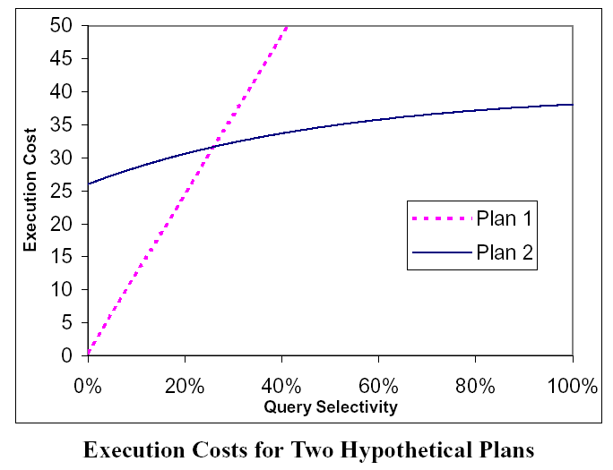
The Performance/Predictability Tradeoff
Which plan is preferable?
Plan-1, if query selectivity is less than 26%.
Plan-2, if the query selectivity is greater that 26%.
Notes:
The query optimizer cannot know in advance what is the exact selectivity of a given query, it must rely on selectivity estimates.
The use of a distribution over possible cost values rather than a single fixed cost, reflects the fact that the optimization is uncertain about the query selectivity.

Slide 13
The Performance/Predictability Tradeoff
As selectivity varies, execution cost of Plan-2 does not vary so much, there is no risk for it to have high cost.
However, cost of Plan-1 varies so much as selectivity varies. It may have very small or very large cost value, depending on the selectivity.
When the probability distribution for selectivity is collapsed to its expected value, as done in previous studies, the information is lost. Therefore, it should not be claimed that “the query plan that has least expected cost is selected”.
Notes:
The query optimizer cannot know in advance what is the exact selectivity of a given query, it must rely on selectivity estimates.

Slide 14

Reasoning About Uncertainity
How can knowledge of the probability distribution for selectivity be used to improve the query optimizer?
How can such a probability distribution be estimated?

Slide 15
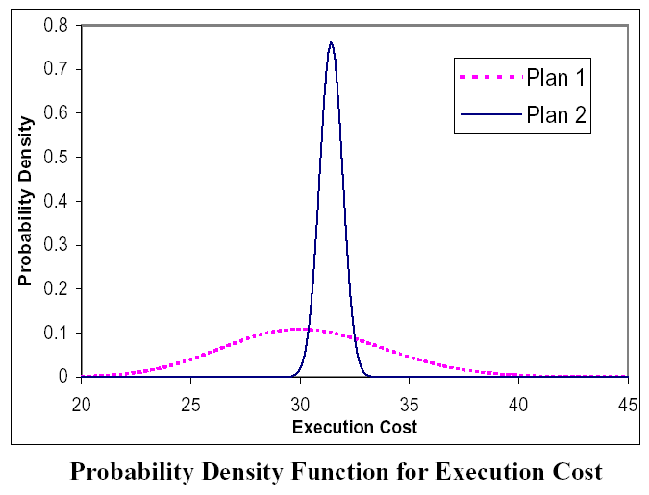
Incorporating the Probability Distribution
Which plan is preferable? → Which part of the probability distribution is more important?
The middle part, i.e. the “typical” behavior
The right-hand tail, i.e. the “realistic worst case” behavior
Notes:
Assume for a moment that the optimizer is able to derive probability distributions for the execution cost of each query plan.
(Under the assumption that query execution cost is monotonically increasing function of selectivity, it is enough to invert the cdf for selectivity.)
Essentially, the decision comes down to which part of the probability distribution is more important: should the focus be on the middle part of the distribution (i.e. the “typical” behavior), or the right-hand tail of the distribution (i.e. the “realistic worst-case” behavior)?

Slide 16
Incorporating the Probability Distribution
Which plan is preferable?
Plan-1, if minimizing expected cost is the overriding concern.
Plan-2, if users are more risk-averse,
since the slightly higher expected cost of Plan-2 has greater predictability, the risk that the query will take much longer than expected to execute is reduced.
Notes:
Plan-1, if minimizing expected cost is the overriding concern.
Plan-2, if users are more risk-averse, since the slightly higher expected cost of Plan 2 may be compensated for by its greater predictability, which reduces the risk that the query will take much longer than expected to execute.

Slide 17
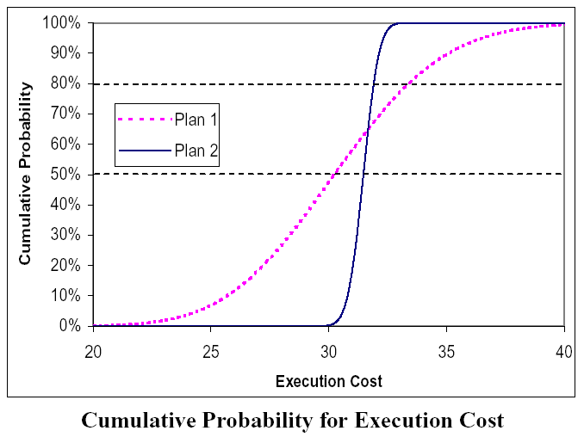
Incorporating the Probability Distribution
Confidence Threshold
The desired tradeoff between performance and predictability is expressed by means of an user/application-specified parameter called as confidence threshold, T%.
T% can be alternatively (and equivalently) described in terms of the cumulative distribution function (cdf) for query execution cost.
T% = cdf(c) c = cdf⁻¹(T%)
Notes:
The horizontal dashed lines in the figure indicate the effect of confidence thresholds of 50% and 80%, and the points at which the cdf curve for each query plan crosses the dashed lines indicate the cost estimates that would be used for each query plan at each confidence threshold. As can be seen from the figure, Plan 1 would be preferred at confidence thresholds less than 65% whereas Plan 2 would be preferred at confidence thresholds greater than 65%.
This is how our selectivity estimation procedure is implemented.

Slide 18
Incorporating the Probability Distribution
Derivation of Execution Cost Distribution
pdf(c) can be derived from
  pdf(s) where pdf(s’)= (# of occurence of s’ ) / (# of tuples)
  cost function c=g(s) that is available implicit form through the cost estimation module
    But deriving cost for various selectivity could be an expensive task.
Under the assumption that query execution cost is monotonically increasing function of selectivity, it is enough to invert the cdf for selectivity. s’=cdf⁻¹(T%)

Slide 19
Selectivity Estimation via Sampling
In this study, the selectivity estimation is performed using uniform random samples of the relations in the database.
  It improves robustness of the query process.
During query optimization, the cardinality estimation module is invoked for each relational subexpression.
For each such expression, how many tuples satisfy the expression is counted.
The number of satisfying tuples and the overall number of tuples in the sample are used in pdf calculation.

Slide 20
Selectivity Estimation via Sampling
Random sampling has some advantages over most selectivity estimation techniques:
  It does not use the AVI assumption, so estimation errors are lessen
  The dimensionality of the data does not affect the accuracy of random sampling
  It is simple to implement

Slide 21
Deriving the Probability Distribution
Suppose database consists of N tuples
The predicate is satisfied by pN tuples
(fraction of p of the database satisfies the predicate and 1-p do not)
Probability of selecting k tuples out of N satisfying the predicate
  P(X|p): Bernoulli distribution = p^{k}.(1-p)^{(N-k)}

Slide 22
Deriving the Probability Distribution
The unknown quantity p is treated as a random variable
Aim is to find the conditional probability distribution for p=z, given the observed data X
The conditional density: (Bayes’ Rule)
pdf(p=z|X) = P(X|p=z).pdf(p=z) / P(X)
posterior = likelihood*prior / evidence

Slide 23
Deriving the Probability Distribution
Bayes’ Rule: pdf(p=z|X) = P(X|p=z).pdf(p=z) / P(X)
P(X): Does no depend on z, common for all p=z
P(X|p=z) = z^{k}.(1-z)^{(N-k)}
pdf(p=z): Prior knowledge about query workload is lacking
  is assumed to be uniform distribution f(z)=1 for 0<=z<=1
  OR
  is assumed to be beta distribution (most widely accepted non-informative prior) f(z) ≡ z ^{-1/2} .(1-z) ^{-1/2}

Slide 24
Summary of the Estimation Procedure
The optimizer searches the optimal plan through many possible query plans.
During this search, the optimizer makes a number of subroutine calls to the cardinality estimation module to estimate the size of various intermediate query results.
In this study, the cardinality estimation module is modified to estimate the selectivity of each query predicate:

Slide 25
Summary of the Estimation Procedure
Determine the appropriate random sample of the data to use, based on the relations involved in the query expression.
Evaluate the predicate on the sample and use Bayes’ rule to infer a probability distribution for selectivity.
Choose the proper confidence threshold T% based on user preferences and compute the selectivity
s = cdf⁻¹(T%).
Return ‘s’ as the estimated selectivity of the predicate.

Slide 26
Analysis
An example
Assume a simple linear cost model:
the execution time for query plan P_{i} = v_{i}*pN + f_{i}
  pN: the number of tuples satisfying the query predicate,
    p: the query selectivity
    N: total number of rows
  v_{i} is the incremental cost per tuple for plan P_{i}
  f_{i} is the fixed overhead, independent of query selectivity, for plan P_{i}

Slide 27
Analysis
An example
Plan-1 and Plan-2 roughly resemble an index intersection plan and a sequential scan plan.
The parameter values that are chosen empirically:
  N = 6.000.000,
  f₁ = 5, v₁ = 3.5×10⁻³
  f₂ = 35, v₂ = 3.5×10⁻⁶
The crossover point where plan Plan-2 becomes better than plan Plan-1 is at a selectivity of;
p_{c} = (f₁-f₂) / (v₂N-v₁N) = 0.14%
Notes:
Index intersection plan identifies the qualifying records based on the indexes and then retrieves just those records will perform well if the number of records to be retrieved is low. However, since the index intersection plan requires one random disk read per record, it fares poorly when the selectivity is high.
The cost of a sequential scan plan, on the other hand, is essentially independent of the query selectivity.

Slide 28
Analysis
An example
If the query optimizer knew the actual query selectivity exactly, it would always choose
  plan Plan-2 whenever the selectivity p < the crossover point p_{c} and
  plan Plan-1 when p > p_{c} 0.14%.
Instead, the estimated selectivity s’=cdf⁻¹(T%) will be compared with p_{c}

Slide 29
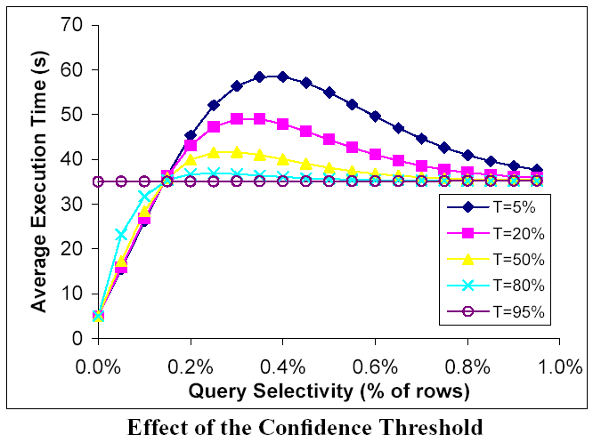
Analytical Results
  Higher T% ➔ the query optimizer more prone to overestimation.
  (The optimizer choses P2 when P1 would be better)
Lower T% ➔the query optimizer more prone to underestimation.
(The optimizer chooses P1 when P2 would be better)

Slide 30
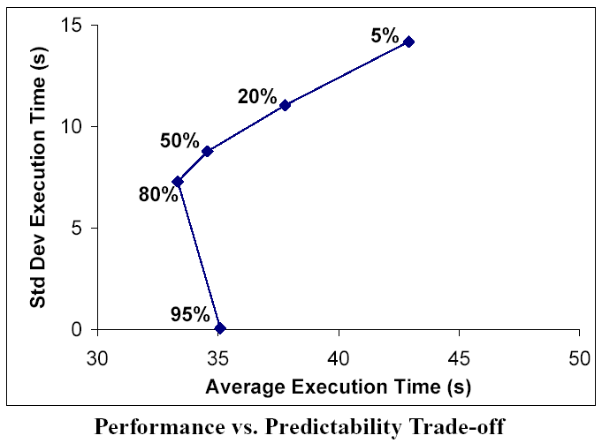
Analytical Results
  The moderate settings T% are better than extremely high or low settings at producing low expected execution times.
  The higher T% ➔ the less variability occurs in the query optimization time

Slide 31
Experiments
The query optimizer of a commercial DBMS, Microsoft SQL Server, is modified by replacing the existing histogram-based cardinality estimation module with the proposed module.
Larger selectivities are easier to estimate accurately, so estimation error is less when the selectivity is higher. Therefore, low-selectivity queries are concentrated.
The TPC-H benchmark dataset (~1 GB) is used.

Slide 32
Experiments
Single-Table Query Scenario
The template used for this scenario is
  SELECT SUM(extendedprice) FROM lineitem
  WHERE shipdate BETWEEN ’07/01/97’ AND ’09/30/97’
AND receiptdate BETWEEN (’07/01/97’+?) AND (’09/30/97’+?)
The degree of overlap between the set of rows satisfying the condition on shipdate and receiptdate
  is controlled by the value of ‘?’
  varied so that the overall query selectivity was between 0% and 0.6% of the 6 million rows from the lineitem table.

Slide 33
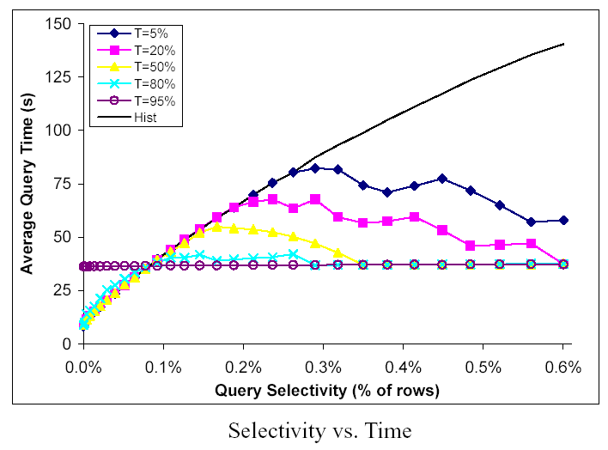
Experiments
Single-Table Query Scenario
The commercial DBMS’s standard estimation module is worse!.. Because it always selects the index intersection plan, which performed poorly at higher selectivities.

Slide 34
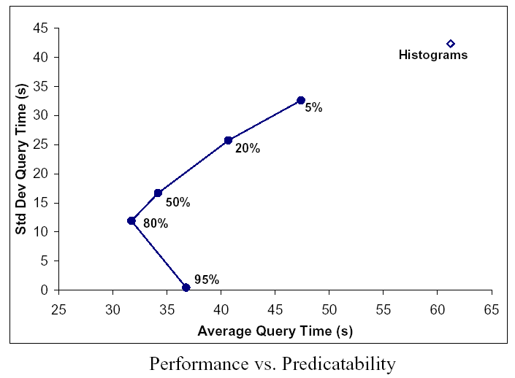
Experiments
Single-Table Query Scenario
Commercial DBMS’s standard estimation is significantly worse!.. Because it always uses AVI assumption even with correlated data instead of Bayes’ Rule.
The variance in execution cost decreases steadily as T% increases.

Slide 35
Experiments
Three-Table Join Scenario
In this query scenario, the query template consists of a natural join between
  the lineitem table,
  the orders table, and
  the part table.
There is an additional selection condition on the part table which is used as the free parameter that is varied in this scenario.
All relations clustered on their primary keys, with additional indexes on the foreign key columns.

Slide 36
Experiments
Three-Table Join Scenario
In this query scenario, the optimal query plan has one of three different structures, depending on the number of rows selected from the part table that satisfy the predicate:
  At low selectivities, the best plan is to first join part to lineitem using indexed nested loops join, and then hash join with orders.
  When the selectivity gets a little higher, the best plan is a sequence of hash joins, first between lineitem and part and then with orders.
  When the query selectivity goes higher than approximately 10%, the optimal plan is to first merge join the two larger relations, lineitem and orders, and then hash join with part.

Slide 37
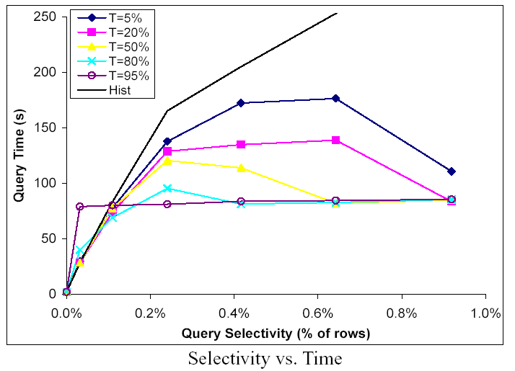
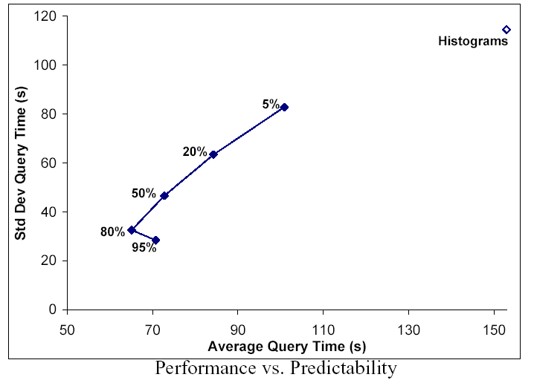
Experiments
Three-Table Join Scenario
Although the types of queries involved in two scenarios are quite different, each of subfigures is similar to its counterpart from the first scenario.
This shows that the properties of the proposed method is applicable for a broader class of queries.

Slide 38
Experimental Conclusions
A confidence threshold of 80% achieves both good performance (low average execution time) and good predictability (little variability in execution time).
A confidence threshold of 95% leads to very stable query plans so it is good for situations where predictability is the major concern.
Confidence thresholds below 50% are rather speculative and are likely to be of limited applicability.

Slide 39

Future Work
As join expressions, only foreign-key joins are used. Extending the techniques to work with the full generality of SQL is a direction for future work.
The time spent in query optimization was about 30%-40% more than time using standard histograms.
  Because the implementation lacks even basic optimization such as memorizing.
Validation of experimental conclusions will be checked through additional experimentation.

Slide 40

Conclusion
“How can we increase the robustness of query optimizers?”
  By one definition, a robust query optimizer is one that generates plans that work reasonably well even when optimizer assumptions fail to hold.
  In this study, a novel cardinality estimation procedure is developed that manages uncertainty in a principled way by reasoning probabilistically about selectivity.

Slide 41
Conclusion
Users should be allowed to prioritize performance criterions.
  In the estimation technique in this study, the query planning process is incorporated with user or application preferences about the predictability vs. performance tradeoff, explicitly expressed through the setting of a single parameter.

Slide 42
Thanks for listening
?
Questions

